Slide 1
Housing Sale Price Prediction
STAT 5243 Applied Data Science
Members: Peiyu Yang, Yige Yang, Hanyun Hu, Quanyin Liu
March 21st, 2023

Slide 2
Introduction

Slide 3
Overarching Goal:
Develop a predictive model to estimate the housing sale price
Provide some potential suggestions for real estate agency companies and people that intend to sell or purchase houses.
Modeling Procedure:
Data Exploration
Identify important features
Modeling Fitting and Hyperparameter Tuning
Predict the housing sale price
Analyze Results

Slide 4
Data Exploration

Slide 5
Data Exploration
Basic Information:
Procedure:
Data Cleaning
Categories Selection
Split data
Data Size:
1460 rows
80 columns
Number of features: 80
Numerical feature: 38
Categorical features: 42

Slide 6
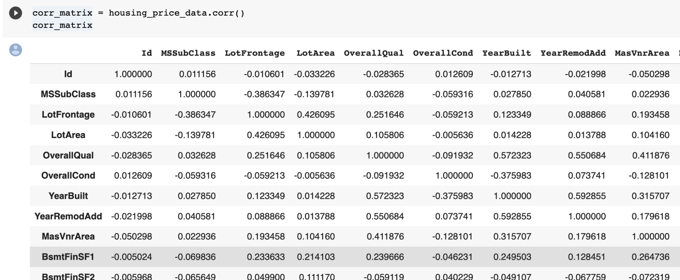
Correlation between Categories
Notes:
Since there are many categories in our dataset such as “lot area”, “street”, “overallqual” etc, we choose to calculate the correlation between different variable.

Slide 7
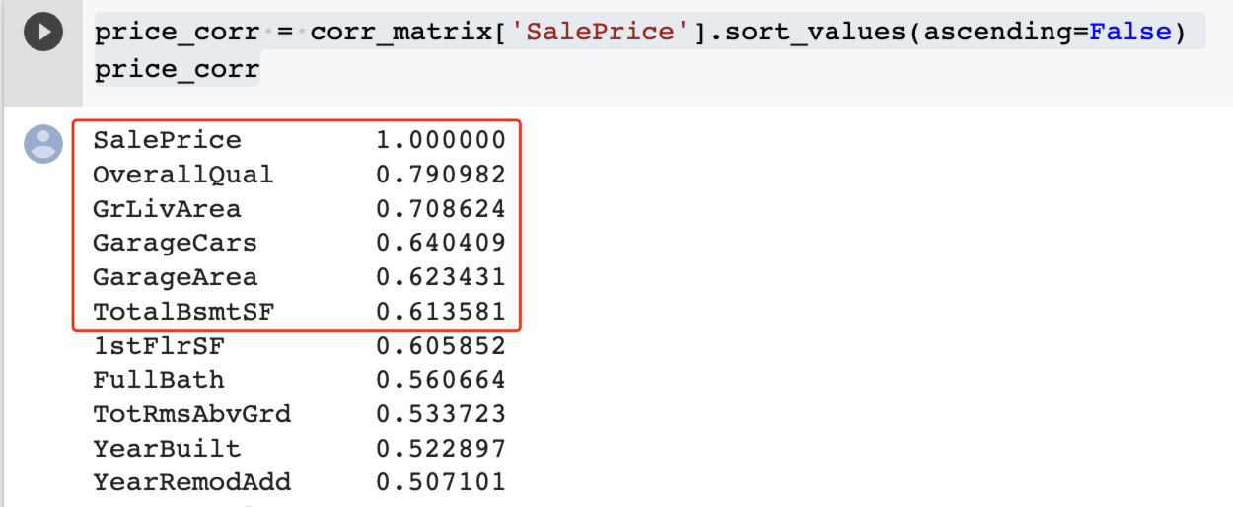
Categories Selection
OverallQual – Overall material and finish quality (Physical feature of the building)
GrLivArea – Above grade (ground) living area square feet (total square footage of the livable space)
GarageCars – Size of garage in car capacity
GarageArea – Size of garage in square feet
TotalBsmtSF – Total square feet of basement area
Notes:
We are extracting the correlation coefficients between the 'SalePrice' variable and the other variables in our dataset from our previously computed matrix.
Then we select Top 5 coefficients value.

Slide 8
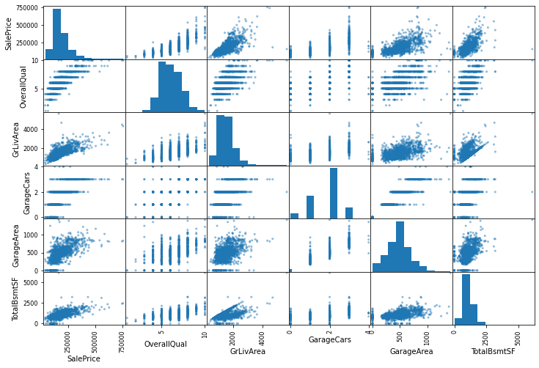
Scatterplot
Visualize the pairwise relationship between our five categories.
Notes:
We can see they all have a positive correlation with “SalePrice” and almost a linear.

Slide 9
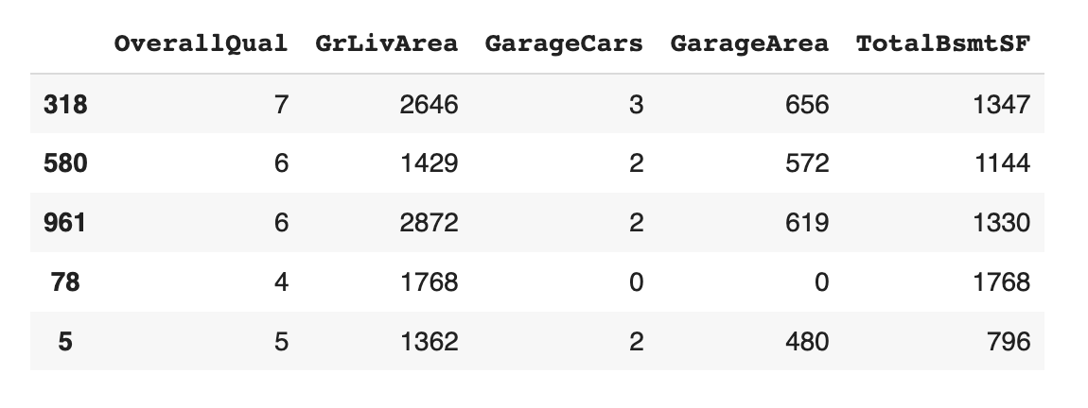
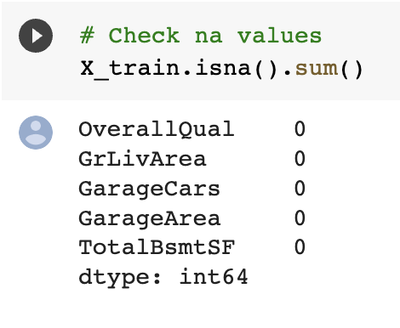
Train and Test Split
Data Cleaning – Missing Values
Split 80% train and 20% test and use random_state=123 for consistency.

Slide 10
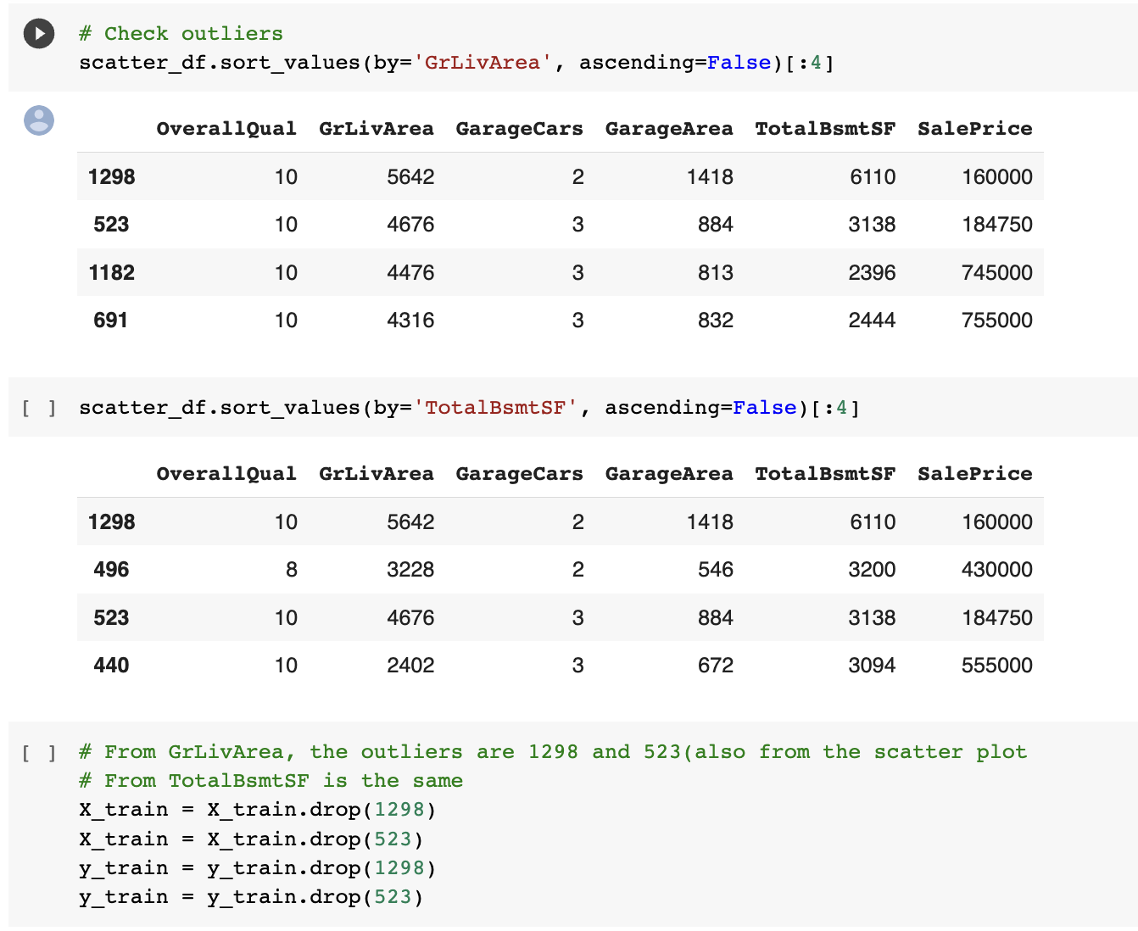
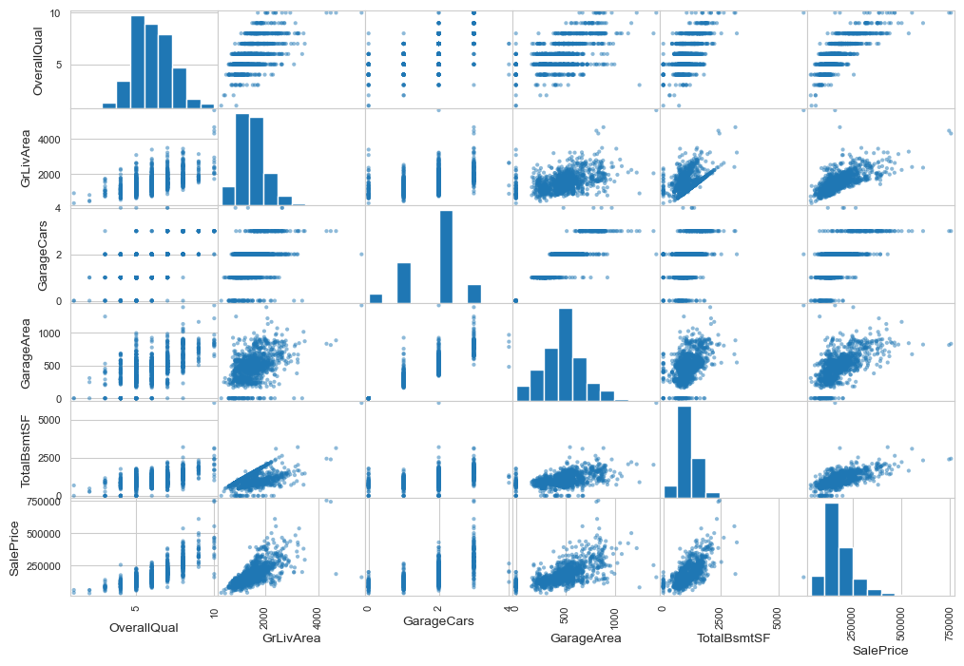
Data Cleaning - Remove Outlier
Notes:
From scatter plot, we can see there are some points in GrLivArea and TotalBsmtSF out of our trend, so we remove the outlier.

Slide 11
Model Fitting
and Hyperparameter Tuning

Slide 12
Model Selection
Which model we used:
Multi-Linear Regression
Decision Tree Regression
Gradient Boosting Regressor
XGBoost Regressor
What will we do:
Fine tune our model and calculate the cv accuracy
Choose the best model
Use the best model make prediction

Slide 13
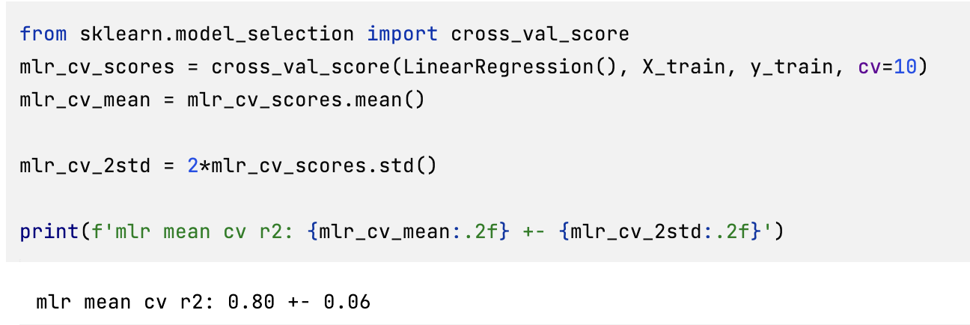
Multi-Linear Regression Model

Slide 14
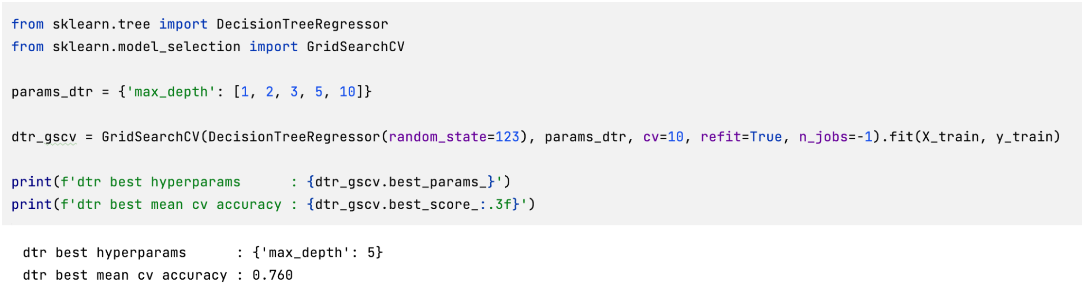
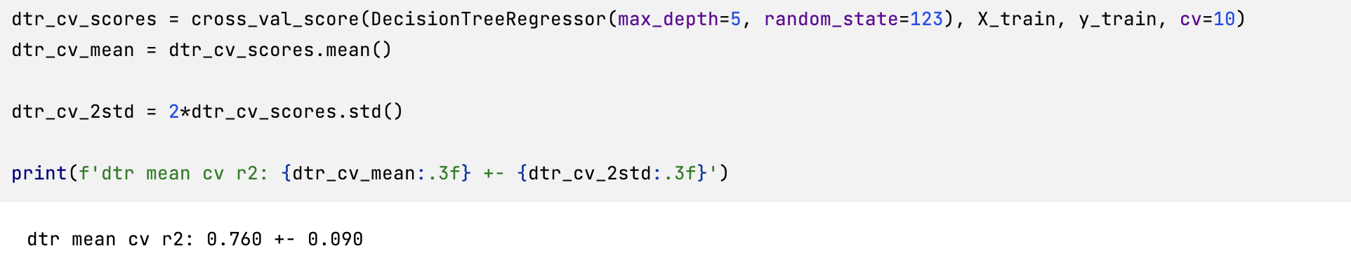
Decision Tree Regressor Model

Slide 15
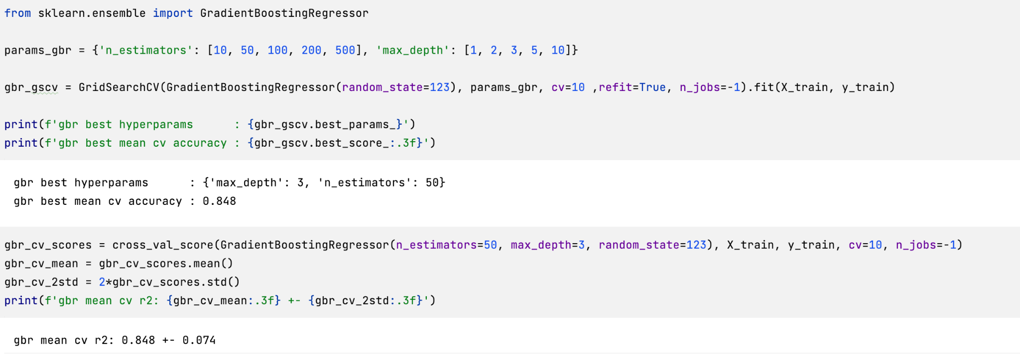
Gradient Boosting Regressor Model

Slide 16
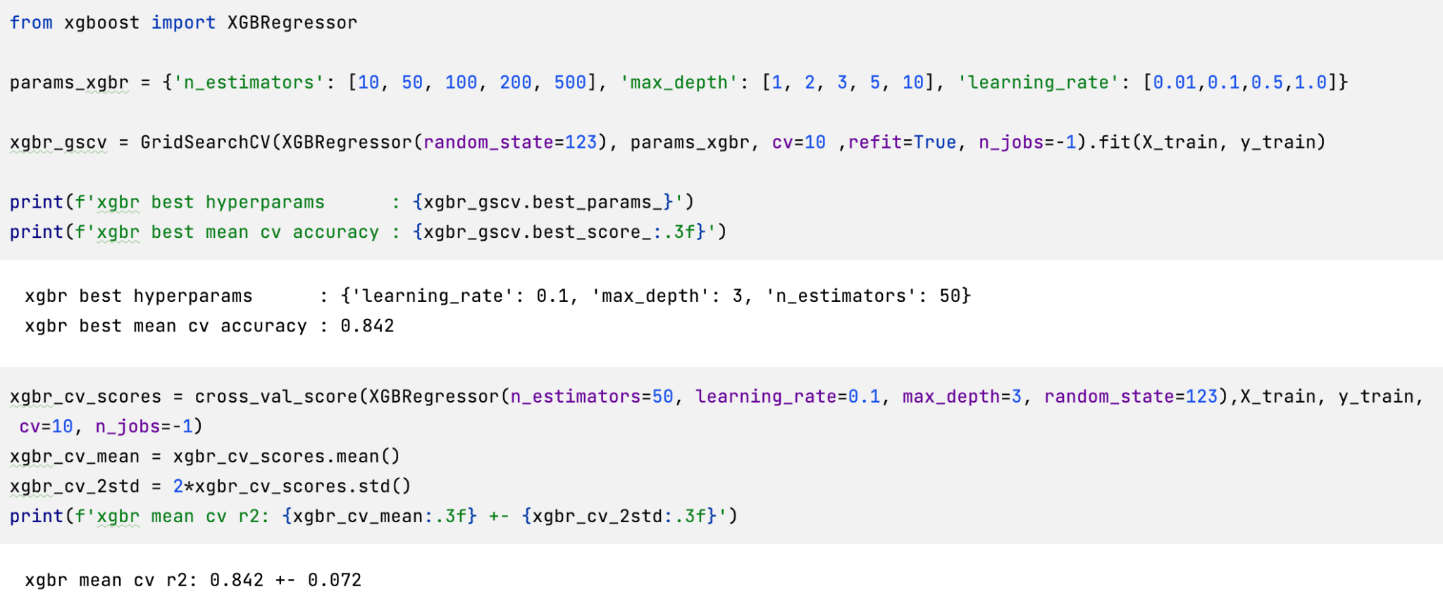
XGBoost Regressor Model

Slide 17
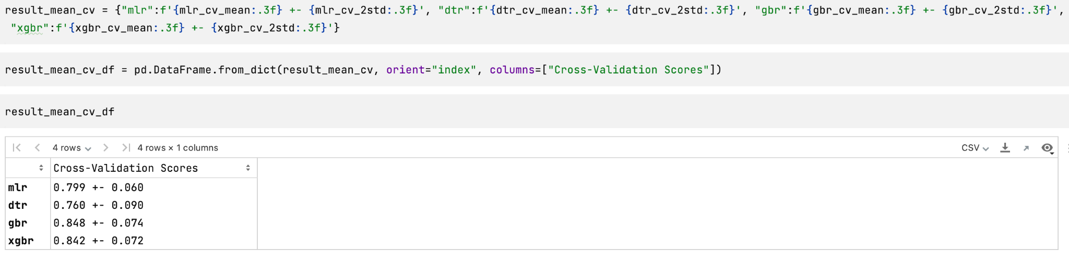
Model Cross-Validation Score

Slide 18
Prediction from Test Dataset

Slide 19
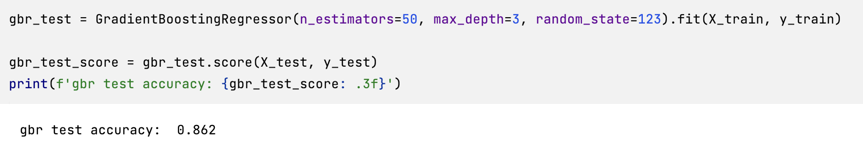
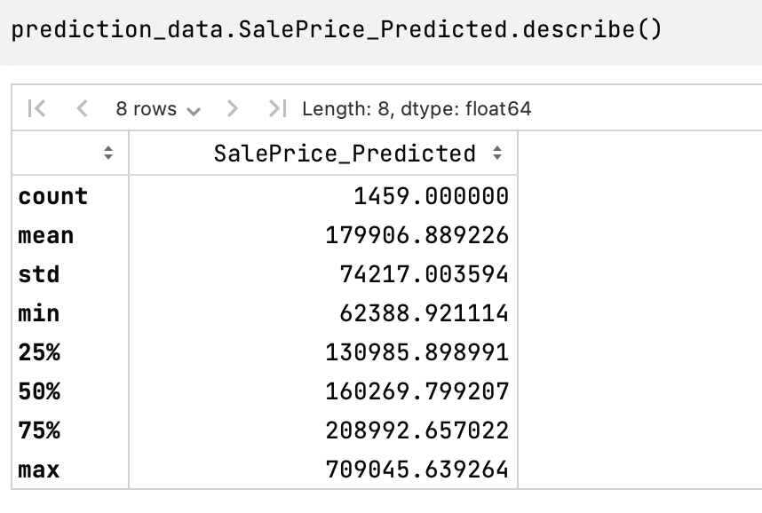
Prediction from Test Dataset

Slide 20
Suggestions

Slide 21
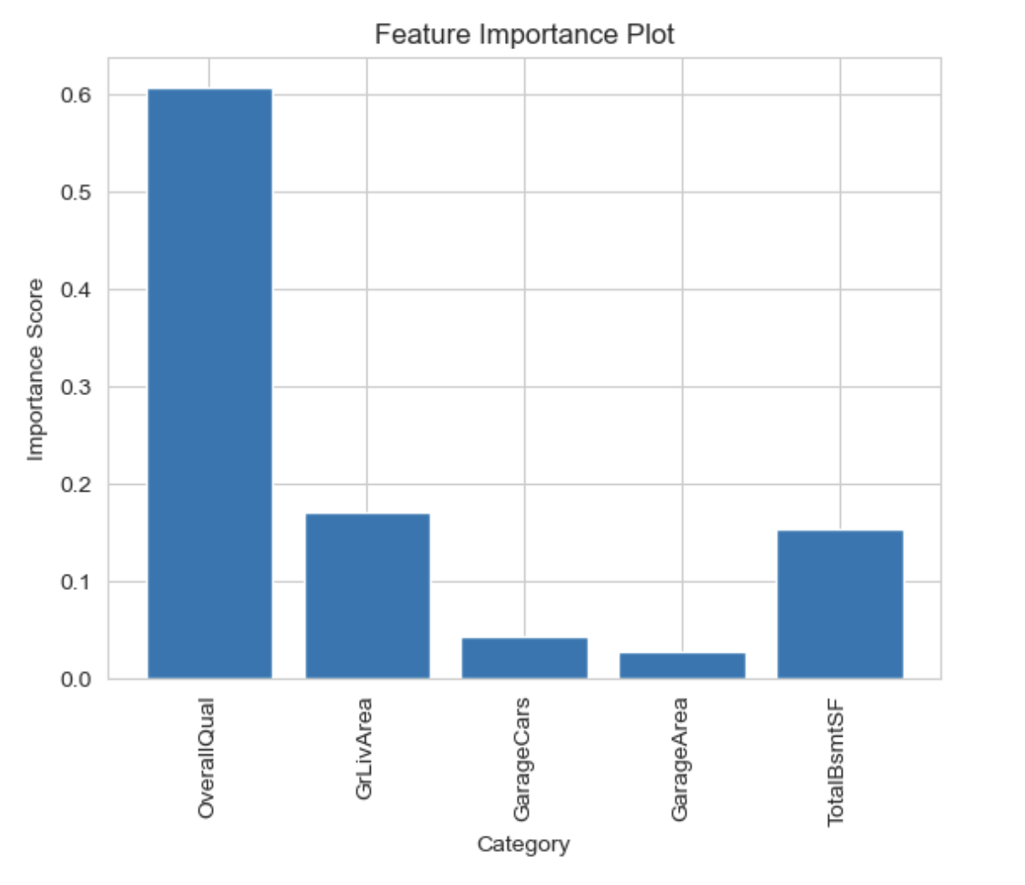
Suggestions for Real Estate Agency
Suggestion 1:
Emphasize the importance of Overall Quality.
Make sure that clients are aware of the importance of overall quality when buying or selling a house. Encourage them to pay attention to the quality of the materials and finishes in a home, as this can have a significant impact on its value.
Suggestion 2:
Market homes with high Overall Quality.
If you have properties with high Overall Quality ratings, make sure that this feature is highlighted in the property listings and marketing materials. This can help attract potential buyers who are looking for high-quality homes.
Overall quality is the most important factor in determining the sale price of a house.

Slide 22
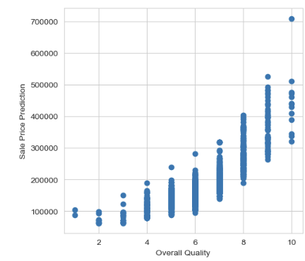
Suggestions for people with purchase intention
Suggestion 1:
Prioritize homes with high overall quality.
When looking for a home to purchase, prioritize homes with high Overall Quality ratings. This will likely result in a higher-quality home that will retain its value over time.
Suggestion 2:
Consider the potential for upgrades.
If you find a home with a lower Overall Qual rating, consider whether there is potential to make upgrades that will improve the quality of the home. This can be a way to get a good deal on a home and increase its value over time.

Slide 23
Thank You for Listening!

